Slide 1
Image Steganography Using Python
Presented By : Sudula Sai Charan
College Name : Cmr College Of Engineering and Technology
Department : Btech(CSC(Cyber Security))

Slide 2
OUTLINE
Problem Statement
Technology used
Wow factor
End users
Result
Conclusion
Git-hub Link
Future scope

Slide 3
Problem Statement
With increasing concerns over digital privacy, there is a need for a secure and efficient way to hide sensitive information within images. Traditional encryption methods are noticeable, whereas steganography enables discreet communication without raising suspicion. The rise in cyber threats and surveillance has made it essential to develop secure communication techniques. Steganography offers a solution by embedding secret messages within digital images in a way that remains undetectable. This project aims to implement an easy-to-use tool for secure message encoding and decoding using image steganography.

Slide 4
Technology used
Programming Language: Python
Libraries: Tkinter, PIL (Pillow), ttkbootstrapImage
Processing: LSB (Least Significant Bit) Steganography
GUI Framework: Tkinter with ttkbootstrap for a modern UI

Slide 5
Wow factors
Password-Protected Encoding & Decoding (Ensures message security)
User-Friendly GUI (Tkinter with a modern Bootstrap-styled theme)
Supports Custom Output File Names
Visual Feedback (Displays images before encoding & decoding)

Slide 6
End users
Privacy-Conscious Individuals (Secure personal messages)
Journalists & Whistleblowers (Safely share sensitive information)
Cybersecurity Enthusiasts (Understanding digital steganography)
Educational Purposes (Learning about information hiding)

Slide 7
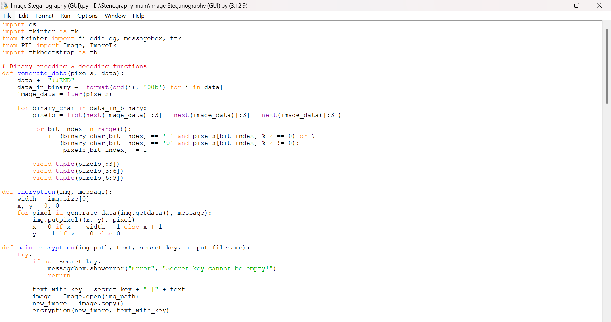
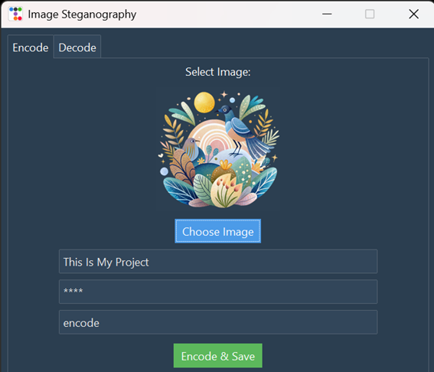
ReSULTS
Figure 1:Code
Figure 2:Encode

Slide 8
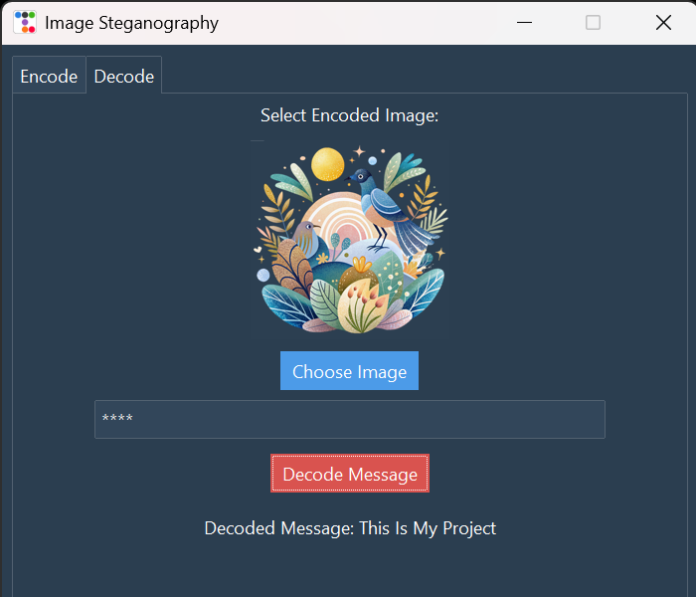
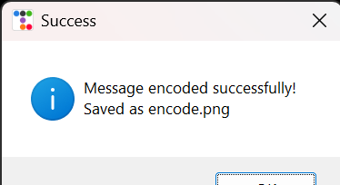
RESULTS
Figure 3:File Saving
Figure 4:Decode

Slide 9
Conclusion
This project successfully implements image steganography using Python, allowing users to securely encode and decode messages within images. With an intuitive GUI and password protection, it enhances data security and privacy while being simple to use. By integrating modern UI elements and providing a seamless encoding and decoding experience, this project ensures that even non-technical users can benefit from steganography. The approach balances usability with security, making it a practical solution for real-world applications. Future improvements could include more advanced encryption techniques and multi-format image support to broaden its usability.

Slide 10
GitHub Link
https://github.com/Saicharan1631/Image-Steganography.git

Slide 11
THANK YOU

